Slide 1
Stock Open Price Prediction as a service
By:
Anusha Basavaraja
Suresh N Nayak

Slide 2
Components
Kubernetes, deployment and scalability
Neural Networks model to predict stock open price
rabbitMQ, messaging
redis, database
Flask REST server

Slide 3

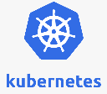

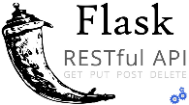


Architectural Diagram
RabbitMQ
REST Client
REST Server
Worker
Kubernetes Cluster
Redis database

Slide 4
Debugging
Logging with RabbitMQ
Installing packages of suitable versions
Modifications of NN model as per our need
Cluster communication

Slide 5
Learnings
Working with multiple systems and their integration.
Debugging system errors.
Scalability with the help of deployment in Kubernetes.
Great hands-on using GCP.

Slide 6
Thank You!

